Slide 1

Business Case #5 Retail Challenge
Ana Sofia Silva, number: 20200220
José Francisco Alves, number: 20200653
Miguel Nunes, number: 20200615
Mohammadali Gharghi, number: 20200997

Slide 2
Presentation Structure
Business Goals
Help the business management to have known of the types of customers
Provide an understanding of the business and important insights
Understand each Point-of-Sale characteristics
Knowledge of the future product’s demand
Expected Outcomes
Customer segmentation
Visual aid to business insights
Product’s Forecasting
Data Mining Goals
Clustering with K-Means algorithm and RFM methodology
Forecast with ARIMA methodology and Top products filtering

Slide 3


Data Understanding and Transformation
Import the data with PySpark tool
Delete irrelevant information of the ID’s columns
Create the new columns for Units, Measures and Unit Price
Cast the Data Types and Remove Duplicates

Slide 4

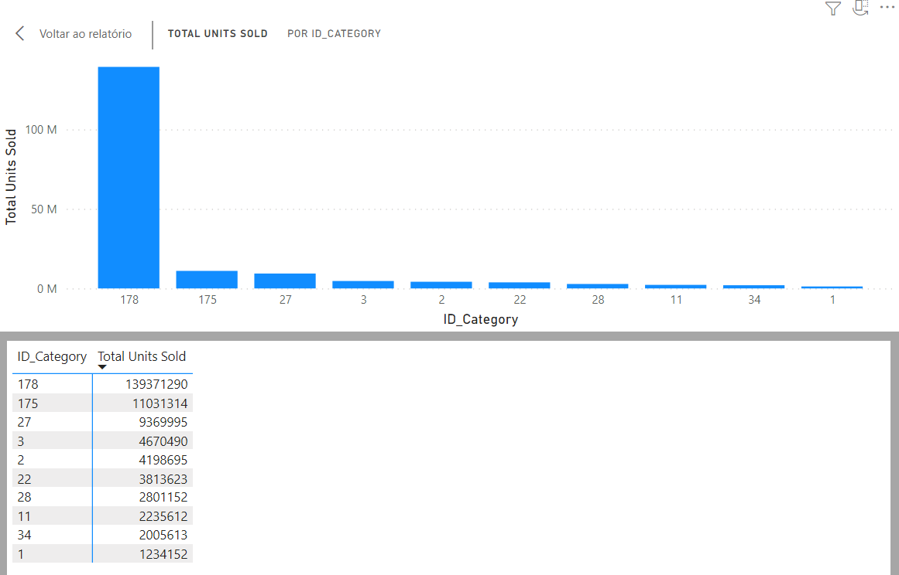
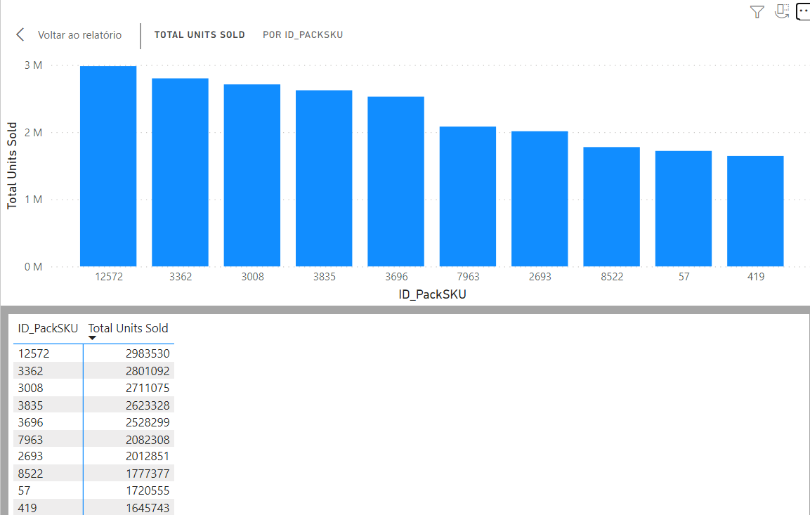
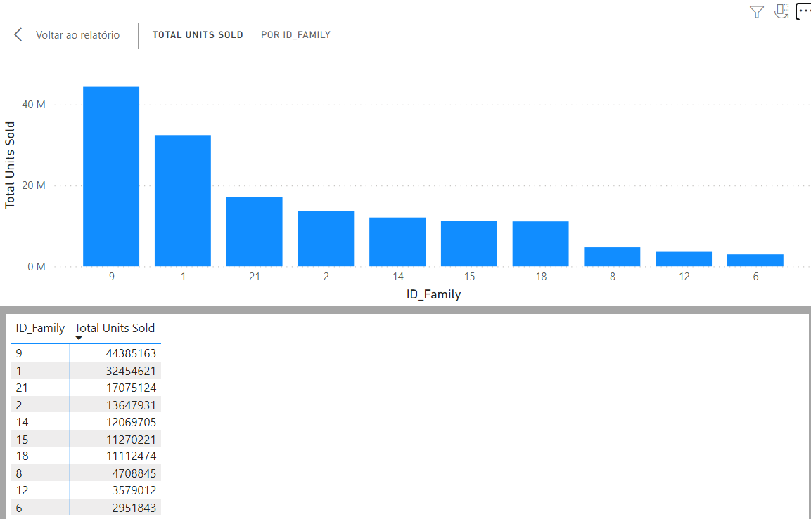

Top products sold by ID’s

Slide 5

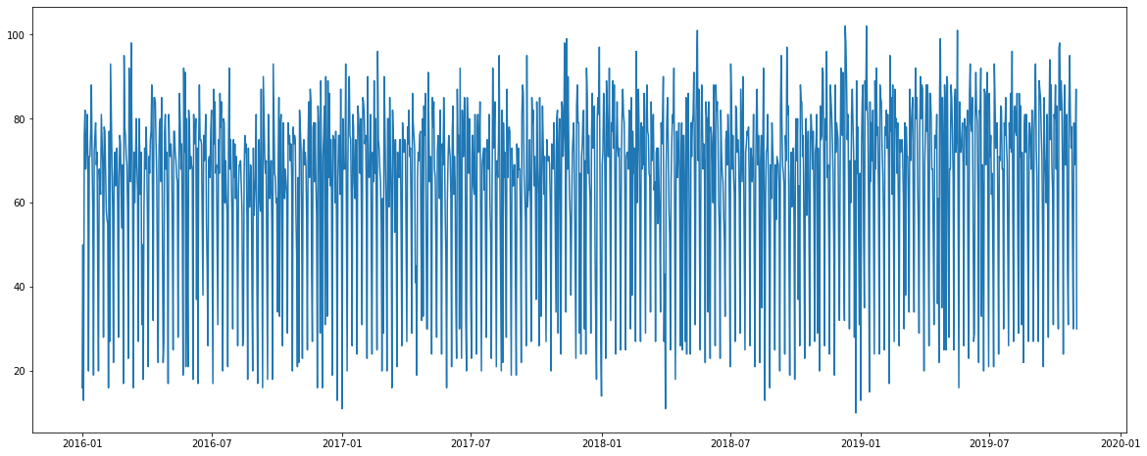
Analysis of each Point-of-Sale characteristics
The Point-of-Sales with higher number of transactions
The number of transactions during the time

Slide 6

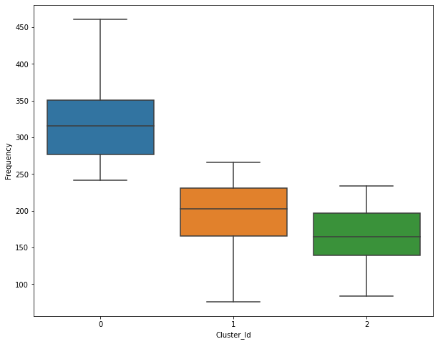
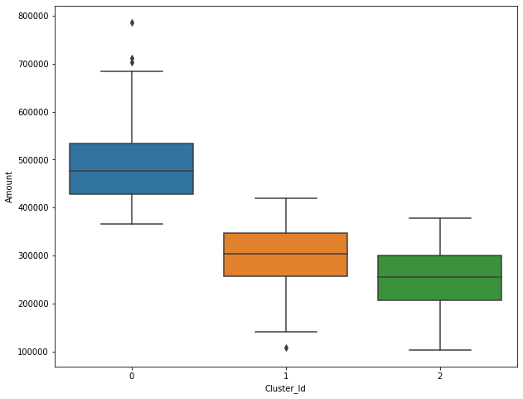
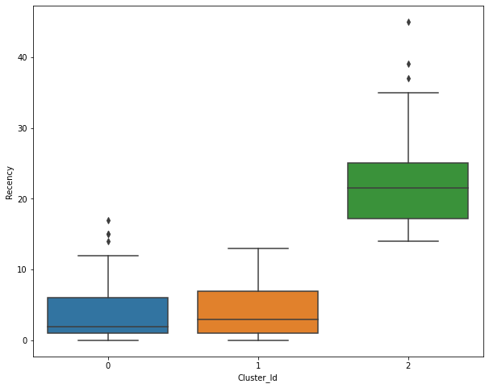
Clustering Analysis with RFM
Recency, Fequency and Monetary Analysis
Normalization of the RFM dataset
3 clusters
Customers with Cluster ID 0 are the customers with high number of transactions as compared to other customers, spend higher amounts of money and are frequent buyers.
Customers with Cluster ID 1 are frequent buyers.
Customers with Cluster ID 2 are not recent buyers and hence least of importance from business point of view.
Notes:
RFM stands for Recency, Frequency, and Monetary value, each corresponding to some key customer trait

Slide 7

Units Products forecast
Units Products Forecast with ARIMA
Prediction based on Point-of-sale
Notes:
For the first part of the challenge, the prediction of the units product 6 weeks ahead, it was used ARIMA models. For that, the values from the ID’s were encoded.
For prediction products based on point-of-sale we made de filtering to point-of-sale to see the top product for each point-of-sale.

